Slide 1
Learning Graphql

Slide 2
Overview
What is Graphql?
REST Drawbacks
Graphql Query
Graphql Schema
Ideas for migrating Rest to Graphql

Slide 3
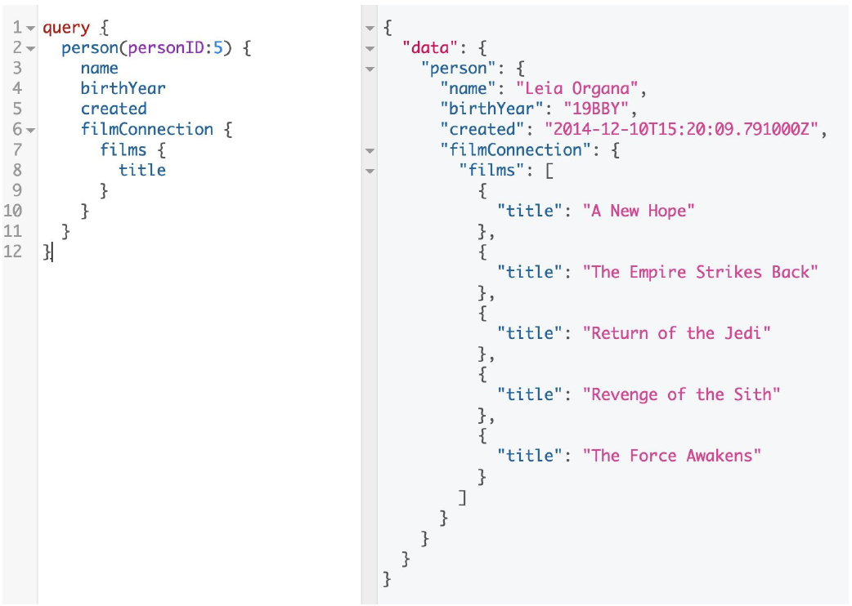
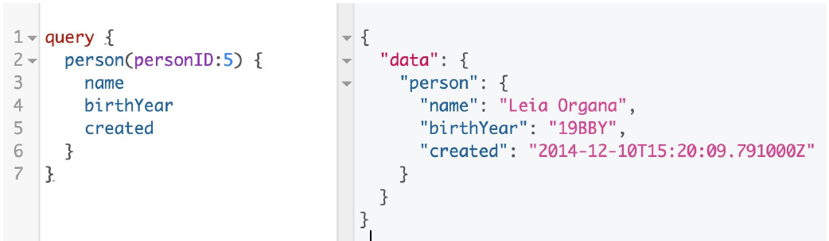
What is Graphql?
GraphQL is a query language for APIs and a runtime for fulfilling those queries with your existing data

Slide 4
Design Principles of GraphQL
Hierarchical
Product Centric
Strong Typing
Client –specified queries
Instropectives

Slide 5
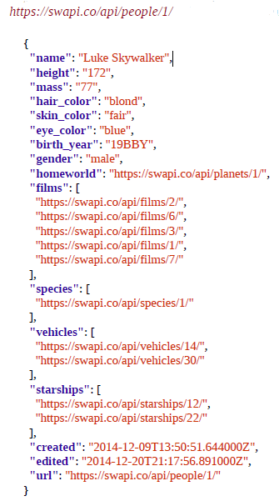
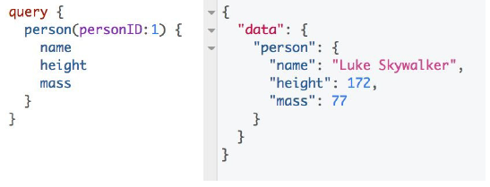
REST Drawbacks that solved by Graphql
Overfetching

Slide 6
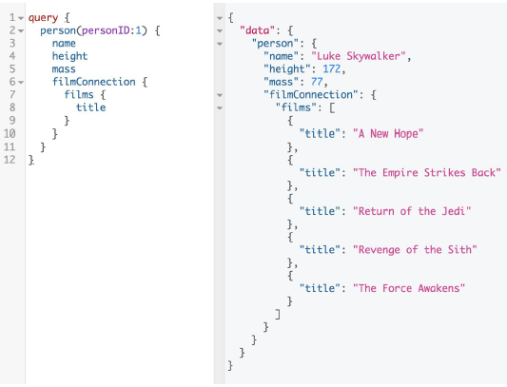
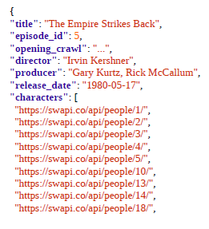
REST Drawbacks that solved by Graphql
Underfetching

Slide 7
REST Drawbacks that solved by Graphql
Managing REST endpoint
GET /api/character/{id}
GET /api/character-summary
GET /api/character-details-with-film-title
POST /api/graphql

Slide 8
Graphql Query
Graphql has 3 root types
Query
Mutation
Subscription

Slide 9
Graphql Schema
Defining Types
Connection and Lists
Arguments
Mutations
Input Types
Return Types
Subscriptions

Slide 10
DEMO

Slide 11
Reference
https://www.youtube.com/watch?v=I3NBPHA5coo

Slide 12
THANK YOU

